Slide 1

SMART INDIA HACKATHON 2026
Problem Statement ID – SIH26209
Problem Statement Title- Student Innovation-Space technology refers to the application of engineering principles to the design, development, manufacture, and operation of devices and systems for space travel and exploration.
Theme- Space Technology
PS Category- Software
Team ID-
Team Name – Stellar Nexus

Slide 2
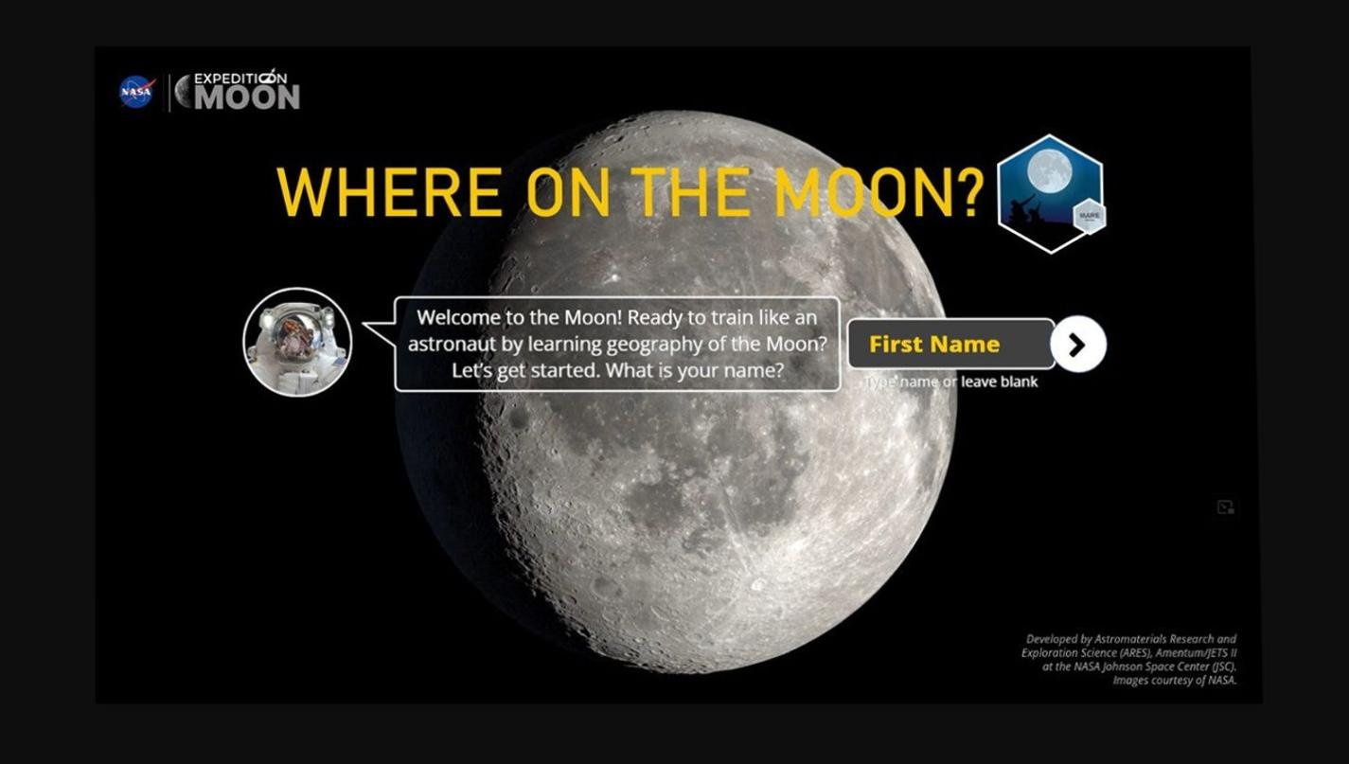
Lunar Exploration Site Selection & Analysis Platform
Stellar Nexus
Proposed Solution
How it address the problem
Innovations and uniqueness
• Web-based platform for identifying scientifically suitable locations on the Moon.
• Uses available lunar remote-sensing datasets.
• Detect terrain, illumination ,slope, surface characteristics
• Calculate the suitable score for candidate location
• Start ranking them and then display them in the lunar map
• Reduces manual analysis of large lunar datasets.
• Help researchers to identify they exploration sites.
• Provide a single platform for visualization + comparison + decision making.
• Multiple parameters site and suitable scoring.
• Candidate locations can be ranked instead of display.
• Interactive map can makes complex satellite data easier to understand.

Slide 3

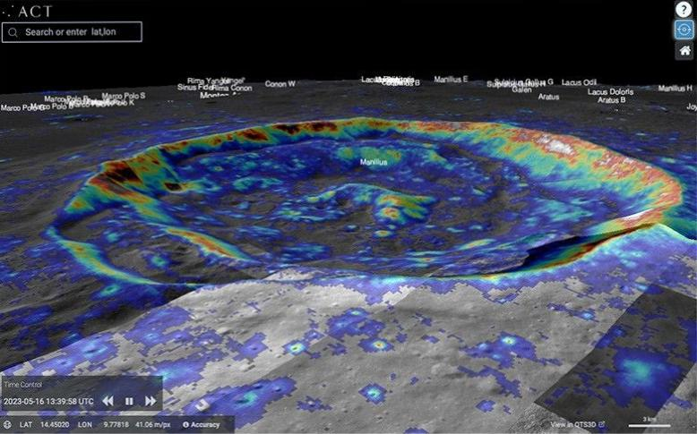
TECHNICAL APPROACH
Stellar Nexus
Technology stack
How it works
• Python
• HTML/CSS
• Geospatial processing
• Web interface
• Satellite datasets
•Mapping and data visualization
• Database for storing analysed locations.
Lunar satellite data
Data preprocessing
Terrain/surface parameter extraction
Suitability Analysis
Suggest best exploration sites
Interactive lunar map
Scoring and Ranking

Slide 4
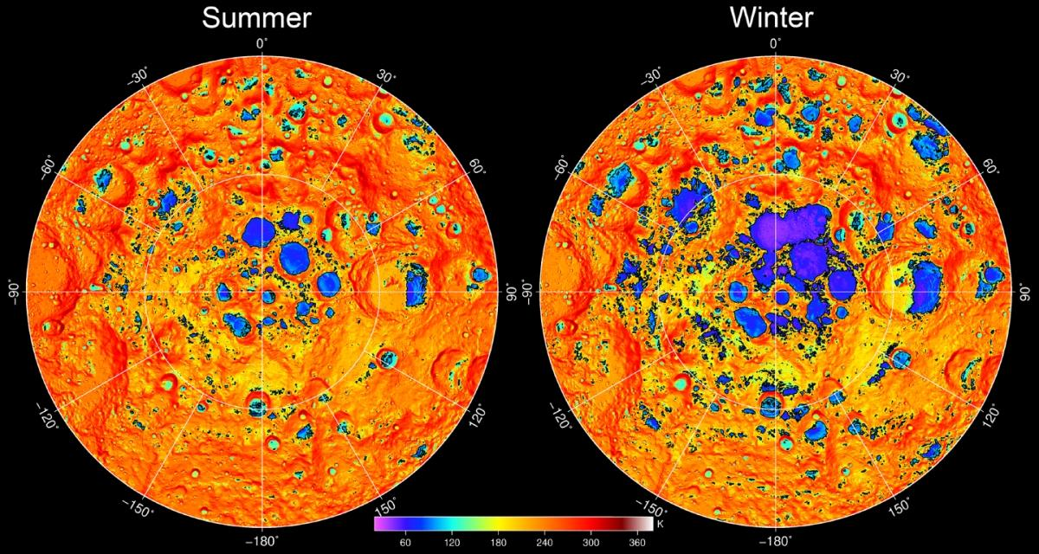
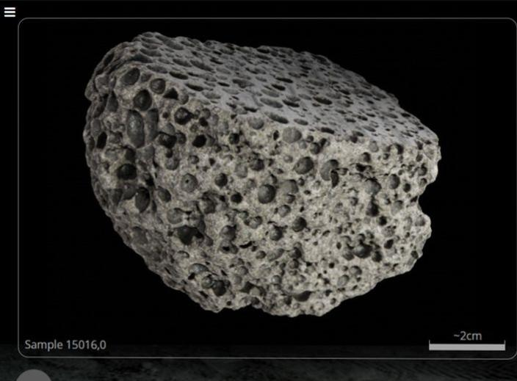
FEASIBILITY AND VIABILITY
Stellar Nexus
Feasibility
Challenges
Our main Focus
• Uses existing lunar remote sensing data.
• Can start with the limited region and scale later.
• Modular design allows additional datasets to be added.
• Large volume Satellite datasets
• Thermal extreme
• Communication blackouts - missing or inconsistent data
• Computational requirement
• Abrasive Lunar dust
•Data preprocessing and standardisation
•Region-wise processing
•Modular architecture
•Weighted scoring system
•Progressive improvement with additional datasets

Slide 5
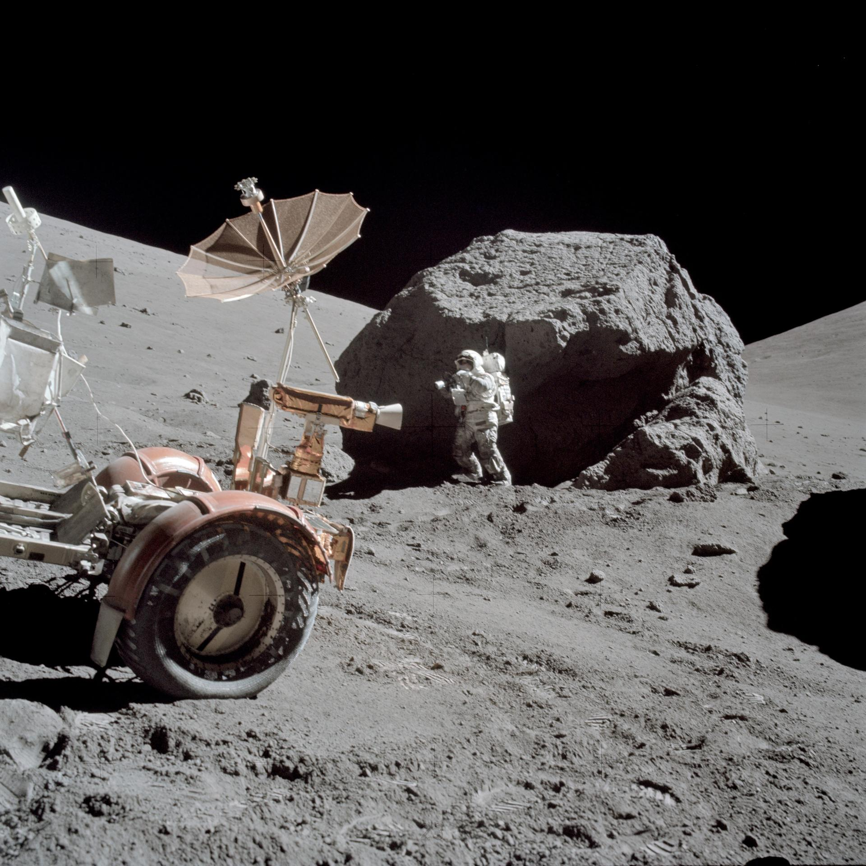
IMPACT AND BENEFITS
Stellar Nexus
Our solution has various useful and beneficiary primary impact on users and various secondary impacts on society .
Impact
• Educational platforms for students and geospace enthusiasts
• Better visualization for lunar terrain
• Potential support for future landing, rover and scientific exploration planning
TARGET USER’S
Benefits
• Space researchers
• Planetary scientists
• Space agencies
• Future lunar mission planners
• Students or research institutions
•🛰️ Better utilisation of lunar satellite data
•🌙 Faster identification of promising exploration locations
•🔬 Supports scientific research
•📊 Makes complex data easier to interpret
•🚀 Can support future lunar exploration planning
FROM RAW LUNAR DATA → UNDERSTANDABLE EXPLORATION DECISION

Slide 6
RESEARCH AND REFERENCES
Stellar Nexus
Details of Research work
A detailed research work was done on various aspects of application to make it more efficient and, fast. Many government website were scotched by us to understand there implementation and tactics.
Data and images were taken from different links , which are attached below :
Links:
https://share.google/yCzkdV0Cx2wKJNnOF ( Lunar Data )
https://share.google/iGsuVUiiTWC9szLTV ( Lunar mapping and images )
https://share.google/ndGXDhWBzW2bRMet8 ( Selecting and understanding the parameters)
Chartgpt- used for brainstorming, conceptual explanations and organizing research; not treated as a primary scientific source.

